Slide 1
CryptoCoin 101
An updated introduction to Crypto coins and more for Batch & Company, PC
Jesse Markowitz June 21, 2021
Notes:
Presented by Jesse Markowitz – Jesse@YourPersonalCryptoAssistant.com

Slide 2
As we start – some questions for you
Please open your phones and go to https://forms.gle/9YbPimiQ1EsuiBsDA
Notes:
8 question survey – Please help me understand where you are currently in crypto

Slide 3
Jesse Markowitz
Computer Enthusiast / programmer for over 35 years.
Engineering Degree from Georgia Institute of Technology
Executive MBA from University of Texas at Austin
Mined some Bitcoin in 2011 – but not seriously (didn’t keep it)
Got back into crypto currency in 2017, just to buy / HODL (Hold on for Dear Life)
Trading actively (staking, mining, liquidity pools, DeFi) starting in 2020, very profitable, but no bitcoin millionaire
Providing Personal crypto advice at: https://YourPersonalCryptoAssistant.com

Slide 4
Disclaimer
I’m not a CPA
I’m not an attorney
I am not Satoshi Nakomoto
I’m not Nostradamus
I can’t / won’t predict the future of bitcoin or other crypto technology
The purpose of this talk is to discuss some of the basic crypto questions and give you the background understanding to learn what you need to…
Always DYOR – Do Your Own Research

Slide 5
Overview
Basics
Using Crypto
Advanced Topics
Bonus
Things to think about
Questions?

Slide 6
Basics - What is money?
Types of money –
Cash, Gold / Silver, Diamonds, Baseball cards, cigarettes
Bank Deposits, Store Gift Cards, Bonds / Notes, Airline Miles,
Crypto based currencies
Key characteristics of money
Durability
Portability
Divisibility
Uniformity
Limited Supply
Acceptability
What makes money valuable?
Expectation that money received can be exchanged later
Faith in the issuer
US Dollar is backed by our economy, our military and the common belief of its users
Crypto currencies are backed by the economy using that currency, math and the belief of its users
Notes:
https://www.stlouisfed.org/education/economic-lowdown-podcast-series/episode-9-functions-of-money

Slide 7
Basics - What are bitcoins and other cryptos
Bitcoins and other crypto currencies exist electronically (like a bank balance), but not on a central database server. Instead they use a distributed ledger.
Bitcoins exist on a public (shared) ledger – the bitcoin block chain which is a record of all bitcoin transactions.
Other cryptos exist on other ledgers, some public, some private, some distributed widely with many, many nodes and others very centralized.
Having a private key (a very long password) allows you to control / send a coin or part of a coin.
Transactions such as sending coins (spending) are validated by nodes (miners) that confirm the transaction sequence and make sure there is no double spending.
Anyone (everyone) who has a copy of the bitcoin ledger can see every address and amount of every transaction – who got how much from whom and when…
Other distributed ledgers use different math (zero knowledge proofs) that allow the confirmation of transactions without making public all the transaction data

Slide 8
Basics – Crypto Coin Math – part 1
The key idea – certain operations are easy to do one way and very, very hard to do the other way.
Super simple example:
What is 227x229 – your calculator will tell you it’s 51,983.
But how about finding the factors of 282,943 – quite a bit harder.
Now imagine doing that with 256 bit numbers 2^256 =
115,792,089,237,316,195,423,570,985,008,687,907,853,269,984,665,640,564,039,457,584,007,913,129,639,936 (78 digits)
Notes:
227, 229 are 49th and 50th prime numbers. 282,943 = 523x541 the 99th and 100th prime numbers.
https://www.rsok.com/~jrm/first100primes.html
https://en.wikipedia.org/wiki/Power_of_two#Powers_of_1024

Slide 9
Basics – Crypto Coin Math – part 2
This is the basis for digital signature – with the secret key, I can sign it easily. You can verify the signature easily – with the corresponding public key. But when looking at a signed transaction you can’t figure out the secret key.
The distributed ledger is a series of transactions grouped into blocks that are all digitally signed so anyone / everyone can verify they are authoritative.
Since later blocks include some information from earlier blocks, this ensures that earlier blocks can’t be modified – they are chained together to form the block chain.
Notes:
51% attacks / 2016 - $50million Hack. ETH did rollback to reverse the hack
https://www.coindesk.com/ethereum-executes-blockchain-hard-fork-return-dao-investor-funds
2019 ETH poll 61% said should never do it again, regardless of amount of money involved. And almost 20% said only if amount was greater than 2 billion USD

Slide 10
Basics - What is a bitcoin worth? (June 10, 2019)
Worth is determined by what a willing buyer / seller agree to
This may vary on different exchanges (buy beanie babies at the flea market, eBay, Amazon, Christie’s auction house and see the different prices you might get)
There are many crypto exchanges with different fee structures and clientele – prices can vary widely at the same time of any day between the exchanges.
Notes:
https://www.coindesk.com/price/bitcoin
https://www.bitcoinprice.com/predictions/

Slide 11
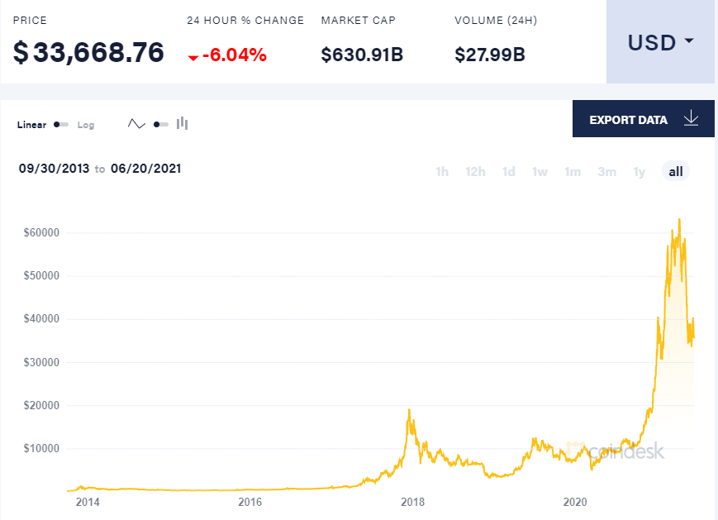
Basics - What is a bitcoin worth? (June 20, 2021)
2 years ago peak was over $18,000 then dropped to almost $3,000
Recent peak of over $63,000 on April 13, 2021 Then dropped almost to $31,000 as in early June, back over $40,000 and on June 20 started at about $34,000.
Notes:
https://www.coindesk.com/price/bitcoin
https://www.bitcoinprice.com/predictions/

Slide 12
Basics - What is a bitcoin worth? (in the future)
It all depends on the assumptions
If Bitcoin went to $60,000 on MicroStrategy / Tesla buying, what happens when other corporations see it as part of investments or cash equivalents.
If Bitcoin market cap matches gold at 10 trillion USD, a single Bitcoin is worth about $500k
Bitcoin becomes monetary standard for the world (John McAfee) - $2.6 million
Also possible:
Bitcoin is surpassed by another / better coin (VHS vs. Beta) = $0.00
Cost of mining exceeds current bitcoin price reducing usage, death spiral = $0.00
NOTE: Some coins have fixed supply (BTC = 21million), others have no limit. ETH has no limit but recently (EIP1559 expected to start in testnet around June 24) introduced a new feature to ‘burn part of transaction fees’ which will reduce the growth in number of coins.
Notes:
Market Cap = price * circulating supply
https://www.bitcoinprice.com/predictions/
https://www.cnbc.com/video/2017/09/13/john-mcafee-claims-bitcoin-is-headed-to-500k.html
https://www.marketwatch.com/story/bitcoin-is-close-to-becoming-worthless-2018-12-03
https://www.coindesk.com/why-1-million-bitcoin-is-coming
https://blog.ethereum.org/2021/06/18/london-testnets-announcement/

Slide 13
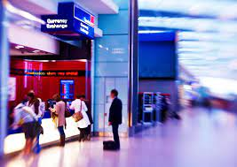
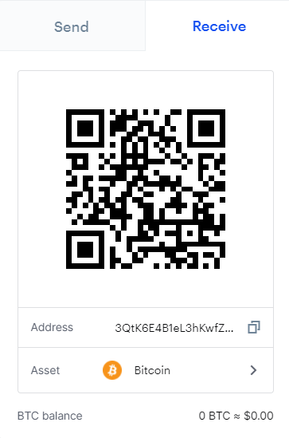
Using Crypto – How do I get one.
PURCHASE - You can purchase it with US dollars on an exchange – just like you can buy foreign currency at the airport from Travelex. There are some operating like an ATM, but most are online. Today Venmo, Paypal, Coinbase, Gemini and many others will take your USD and give you various crypto coins. You can also buy P2P – person to person via people you know or meet via localbitcoins.com and similar services.
GIFT – Someone can send you crypto as a gift – just like an Amazon gift card. Since email is generally insecure this is usually done on paper or via a website. Some organizations have a ‘faucet’ where you can get free crypto
EARN – If you do work for someone they can pay you in crypto – just give them your address and they can send payment directly to that address. Also, there are now at least a dozen WordPress plugins that integrate with Woo Commerce for accepting Crypto.
MINE – You can install software on your computer to be a node that validates transactions on a distributed ledger network. As you do work, you will earn rewards in crypto. If you don’t have a computer that works for this (some block chains require specific types to be effective GPU / ASICs) you can rent mining power by the hour and pay someone else to mine for you and send you the mining rewards
Notes:
https://www.travelex.com/stores-by-state/airport-currency-exchange/newark-liberty-international-airport
Coinbase.com receive screen shows bitcoin address

Slide 14
Using Crypto – Storing it (Addresses / Keys)
When you own some crypto currency, you have an address (generally public) that identifies what you own. For bitcoin, the address looks like:
1FeexV6bAHb8ybZjqQMjJrcCrHGW9sb6uF
You will also have a private key that allows you to prove your ownership of that address. That is a 256 bit number generally shown in a base 58 format that looks like:
5Kb8kLf9zgWQnogidDA76MPL6TsZZY36hWXMssSzNydYXYB9KF
Different coins have minor differences and sometimes the numbers are shown in Hexadecimal (Base 16) or other formats but the idea is the same.
NOTE: To see the balance and transactions on that address above you can use public web tools like:
https://bitinfocharts.com/bitcoin/address/1FeexV6bAHb8ybZjqQMjJrcCrHGW9sb6uF
Notes:
https://bitinfocharts.com/bitcoin/address/1FeexV6bAHb8ybZjqQMjJrcCrHGW9sb6uF shows 79,957 bitcoins added on March 1, 2011. No coins ever removed. Current value about 2.7 billion USD (BTC=$37,000).

Slide 15
Using Crypto – Storing it in Wallets – part 1
The addresses / private keys on the last slide can be hard to remember / work with, so wallets were created.
A wallet is a computer program / application that provides a way to store addresses and matching keys as well as the user interface for generating new addresses / keys, checking balance of your addresses and allowing you to send crypto from your address to any other.
Wallets can be run on many types of hardware – Servers, Regular home computers / laptops (Mac, Windows, Linux), Tablets and Phones
Some Wallets are written to run within a web browser (Firefox / Chrome / Brave)
Other Wallets are designed to run on servers, but be accessed by web browsers
There are dedicated hardware wallets (Often looking like a USB stick)
You can even create a paper wallet – printing the address / key information on a piece of paper

Slide 16
Using Crypto – Storing it in Wallets – part 2
The most important thing to remember about wallets is who has the actual crypto key – Not Your Keys, Not Your Coins
If you have an account on an exchange – it’s like a bank account with a user ID / password to log in BUT they hold the actual crypto key to your coins. They control the crypto, not you. If they go out of business or defraud you or comply with a government request you have no control.
If your crypto is stored in your wallet and you have the keys, you are the only one who controls it. Like cash, this is good because it’s yours and no one can say you can’t spend it. BUT also like cash, it’s bad if you lose the key, or allow it to be stolen.
Notes:
https://www.wsj.com/articles/how-the-fbi-got-colonial-pipelines-ransom-money-back-11623403981
My thoughts – most likely: crypto wallet on a server in server farm in US. FBI told server farm to give up server – so all information on that server (including wallet / keys) was seized. Also possible, ransom moved to an exchange – FBI told exchange to give up crypto. Least likely, FBI sting gone bad, so FBI compliant accomplice had keys to address. Impossible – FBI hacked bitcoin core cryptography.

Slide 17
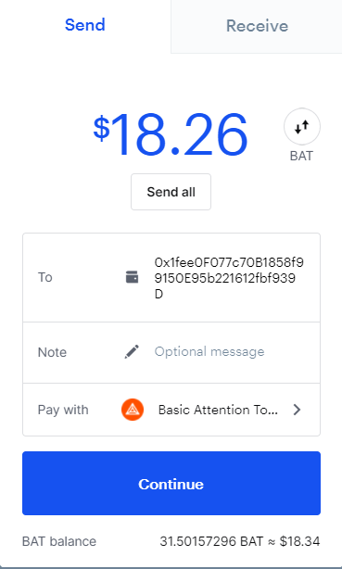
Using Crypto – Spending / Sending
On your device (computer / phone / browser) run software (wallet) that lets you spend (send) your crypto. That program will use your private key to authorize transaction and post to the distributed ledger.
The software used might be:
Your wallet
Program used by a vendor or Exchange website
Key things to be aware of:
Scammers – protect your keys
Gas / Transaction Fees (think shipping and handling)
Notes:
Coinbase.com send screen shows BAT address to send to

Slide 18
Using Crypto – Tracking Crypto Transactions
Just like it is wise to keep track of your cash transactions, it’s a good idea to track your crypto transactions. This lets you know your profit / loss on any coins you purchased. Also, you may owe taxes on transactions and unlike cash – depending on the ledger used your transactions may be published publicly.
Good Practices:
Every transaction should be tracked even though not all are taxable events.
Excel is fine for a couple transactions, but most folks will need more
The tricky part is tracking your basis across multiple wallets / exchanges in fractions of coins
FIFO is often the default, but as with tracking basis in your stock portfolio there are sometimes cases where using named lots can offer a large tax advantage
There are many options – Here is (an affiliate) link to the service I use ZenLedger.io. I like them a lot, but there are many software packages / services that are also quite good.
Notes:
I use ZenLedger.io to help with tracking all my transactions – they calculate the cost basis and prepare tax forms too. The link here is an affiliate link – if you purchase after clicking my link I get a small referral fee.

Slide 19
Advanced Topics - Staking
POW – Proof of Work vs. POS – Proof of Stake
POW – Bitcoin and many others that use competing miners to validate transactions
POS – ARK, BNB, ALGO and others that use staked coins to determine who can validate transactions
Concern in both cases is sufficient validator diversity to prevent single ownership / 51% attacks
What is Staking
Show of support for validating nodes – often rewarded by validators (miners)
Generally limited risks
Some protocols might ‘lock’ your stake, some have fees for staking / unstaking

Slide 20
Advanced Topics – Types of Coins and their usage
Bitcoin – digital gold, reserve currency used for trading pairs. Transactions (buy coffee) are practical only with Level 2 protocols like Lightning network.
Ethereum – digital oil, many tokens built on top of ETH infrastructure / contracts – often industrial applications (DeFi…). Level 2 protocols and improvement proposals assist in helping it scale.
Alt Coins - digital currencies, used for very specific applications
Faster / more efficient than Bitcoin for buying stuff (BCH, LTC)
Cheaper (than ETH) options for trading / defi (BNB, ALGO, ADA)
Tipping via built in app on youtube alternative (LBR)
Funding art projects on Staker network (STR)
Paying professional gamers (EPIC)
Meme Coins – Dogecoin (DOGE), Shiba Inu (SHIB)
Possible Scam coins – Centra (CTR) pumped by Floyd Mayweather, EthereumMax (EMAX) which paid Kim Kardashian to promote it
Stable coins / Central Bank coins – used to store value with minimal volatility
Privacy Coins – digital cash, used to allow more anonymous transactions
Notes:
Over 10,000 alt coins / tokens have already been created

Slide 21
Advanced Topics – Stable Coins and CBDC
Stable coins are designed to have minimal volatility
Most are pegged to the US Dollar (USDT, USDC, GUSD, BUSD, DAI)
There are others BGBP (British pound), EURS (Euros), DGX (1 gram gold)
Reserves backing stable coins vary by coin, but ultimately garaunteed by coin and / or smart contract
CBDCs are Central Bank Digital Currencies
This is basically a government backed stable coin
Much investigation, some trials, nothing released yet
No need for ‘reserves’ just like Fed Reserve can spend money into existence, it could ‘print’ as many dollars as required to support a USA CBDC
May not be distributed ledger
This could disrupt the current monetary system significantly
Notes:
GUSD – Gemin
BGBP – Binance British pound

Slide 22
Advanced Topics – Privacy Coins
What are Privacy Coins
Coins that implement distributed ledgers in ways to protect privacy. The key feature generally is it is difficult or impossible for folks not involved in the transaction to be able to see who sent how much to whom from the distributed ledger. Some implement additional security (e.g. transactions are encrypted or routed through TOR) to prevent monitoring a person’s internet connection looking for privacy coin activity.
Privacy is good for everyone
No one should want to publish their wealth balance to the world
Individuals likely do not want everyone to know where all your money comes from, nor where it is all spent
As a company you would not want your balances / accounts payable / accounts receivables to be made public
Criminals could use Privacy Coins too
Like cash, criminals may try to leverage this technology.
Examples of Privacy Coins include Monero(XMR), Zcash(ZEC), Dash(DASH), Verge(XVG), Pirate Chain(ARRR), Hush (HUSH)

Slide 23
Advanced Topics - Exchanges
Exchanges are places people get together to buy and sell crypto. Key concepts to know about:
Centralized vs. Decentralized exchanges (CEX vs. DEX)
Authentication requirements (KYC / 2FA)
Who has the private keys?
Market orders / Limit orders / Stop-Limit orders
Transaction Fees
Market makers vs LP
Margin

Slide 24
Advanced Topics - DeFi
What is DeFi – Decentralized Finance
Why is it so exciting
Uses smart contracts
Allows common folk to participate in lending / borrowing directly
Risks / Rewards
APYs can be huge
BUT - You can lose all your principal
Regulation
Currently minimal regulations / safety nets
Notes:
https://CoinEx.com/asset/making top 1 day APY on June 20
DeFi risks:
Counterparty risk
Exchange risk
Hack risk
Currency value fluctuation risk
Regulatory risk (confiscation)

Slide 25
Advanced Topics – Liquidity Pools
Liquidity pools are one form of DeFi. They let individuals earn transaction fees by providing liquidity to a trading pair. This removes the need for market makers.
As in the DeFi slide, the APY rewards can be huge, but the risks are commensurate
Stake equal value of both coins in the liquidity pair
One key risk that should be understood if you are going to participate in this is Impermanent Loss.
Notes:
IF you provide LP via USDT and BTC and BTC goes down in price, folks may sell BTC to you for USDT. You wind up with more BTC and less USDT and if BTC went down your LP value could also decline.

Slide 26
Advanced Topics – Non-Fungible Tokens NFTs
Unlike BTC or ETH the value of one token may be much different than another.
You are buying a token (you have the private key to prove you own it) that is associated with ‘something’. Beeple (Mike Winkelmann) sold an NFT of a digital picture for $69 million.
What will it be worth in future? Bragging rights, more millions, or nothing at all? No one knows.
The real value of an NFT is in the ability to use it to enforce ownership elsewhere.
In game (Fortnite special armor / weapons)
Real Estate (where government agency including local sheriff) use NFT as proof of ownership of land instead of title in Count Records office
Copyright (where radio stations, Spotify, Apple Music) pay artists based on token ownership for songs being played.
Notes:
https://www.theverge.com/2021/3/11/22325054/beeple-christies-nft-sale-cost-everydays-69-million artwork was: Everydays - The First 5000 Days

Slide 27
Advanced Topics – Other Crypto use cases
The blockchain – all the blockchains. These can be used for more than just currency.
Digital Record – Recording deeds, Car titles, Contracts, Stock ownership
Digital Identity – proof of identity not tied to biometrics
Tokens – Magic the gathering cards, online game special items
Audit trails – track transactions, contracts and more
Implement Smart Contracts – have the contract automatically enforced
Futures / Options – One implementation of Smart contracts
Notes:
https://marketbusinessnews.com/financial-glossary/altcoins/
https://www.coindesk.com/information/applications-use-cases-blockchains

Slide 28
Advanced Topics – Evaluating coins
When looking at a coin to determine if I’m going to acquire / invest
Why does it exist (Purpose)
What does it do (Technology)
Real World Adoption (How much is it actually used, not just stacked)
Dev team depth and activity (GitHub)
Marketing / Community support (Discord / Telegram)
Price / Market Cap (Market Size) / Exchange availability / Liquidity
Governance (How are decisions made)
Competitive Advantage / Barriers to entry for competitors
DYOR Do Your Own Research, don’t get scammed by pump and dump schemes

Slide 29
Bonus – Can you avoid taxes on your Bitcoin Billions? Part 1
If you bought Bitcoin some years back (sub $1,00) and it really does go to 100k, 500k or more you may expect a significant tax bill.
Many folks think since it’s not dollars in a bank and since the IRS doesn’t have a 1099 on it, you can skip reporting – seems risky to me.
BUT, because the IRS has defined it as property (like a shovel or car) not as money there may be some clever strategies you can try.
As stated earlier, I am not a CPA, nor a tax attorney and the following is certainly not to be considered professional advice. These are ideas for you to explore and consider.
As above DYOR
Notes:
https://www.irs.gov/pub/irs-drop/n-14-21.pdf
https://www.irs.gov/businesses/small-businesses-self-employed/virtual-currencies
https://www.irs.gov/pub/irs-utl/2018ntf-bitcoin-cryptocurrency-an-introduction-and-tax-consequences.pdf

Slide 30
Bonus – Can you avoid taxes on your Bitcoin Billions? Part 2
As stated earlier, I am not a CPA, nor a tax attorney and the following is certainly not to be considered professional advice. These are ideas for you to explore and consider. DYOR
Die. Extreme, but large exclusions on estate taxes and the step up in basis for heirs might work.
Give it to a friend. As long as you stay under gift tax limits, giving your friend 0.1 of a bitcoin is not a taxable event so no capital gains tax. Also, your friend doesn’t report it as income – it’s a gift! NOTE: If your friend sells the bitcoin, they need to calculate their basis to determine the capital gains.
Give it to a charity. Donating appreciated stock has been advantageous for some time. Donating appreciated crypto should work the same.
Borrow against it. Like a reverse mortgage on your house, if you don’t sell your coins there is no taxable event. Use the money borrowed to cover your expenses. Every year borrow more to repay old loan and pay for next year’s expenses. If crypto is stable you can ‘spend’ almost all of it without any tax consequence. If your crypto appreciates, your annual spend can go up also – again with no income tax consequence.
Lend it to others. If you don’t actually sell your bitcoin, but loan it out, that shouldn’t be taxable. The interest they pay you would be income, but you still avoid the capital gains on the original bitcoin.

Slide 31
Final Thoughts to Consider
Crypto can both be used (use case) and held as store of value (HODL)
This has the potential to be world changing. Like the Internet.
We are still early in the cycle – you are not too late.
Think internet in preAOL, dial up days
There are still big risks / rewards available
There will be many losers AOL, AskJeeves, MySpace etc.
It makes sense to stick your toe in – and start learning
Don’t bet it all. Think of this as spending money as Vegas money, or buying an education.
Remember not all fortunes are made mining during the gold rush – Levi Strauss sold denim, others sold pans, eggs and shovels for incredible profits. Analogous profits are here too.
Secure your crypto – it’s like cash and you are responsible for safekeeping YKYC
DYOR – Many people will tell you what to do, but you are responsible for you.
Watch out for fees – the vision is low fees, but the reality varies
Regulation is coming – Fiat on / off ramps are likely to be locked up hard.
Unregulated non fiat platforms can’t be stopped – Crypto is primarily open source leading to easy forking / private projects and can be executied in countries with widely varying laws. Many projects are DAOs or run by anonymous volunteers - there is no person/ company to shut down.
Notes:
https://www.thevintagenews.com/2017/12/06/california-gold-rush-mining-pans/

Slide 32
Next Steps
If you don’t already have an exchange that lets you convert your fiat to crypto, open an account at Coinbase. It’s an easy place to start
Referral link (gets you and me both $10 of bitcoin when you open an account and buy / sell $100 in crypto. https://www.coinbase.com/join/markow_hu
https://www.coinbase.com/earn gets you opportunity to earn crypto by watching their lessons and taking short quizes (modified airdrop)
Use crypto – buy something online with crypto. Have someone send you crypto for something you provide for them. Or send / receive gifts
If you are interested in DeFi, DYOR and start small
If you are interested in investing in coins to be held as investment, DYOR and start small
There are a large number of sites on the web that can help you learn all of this. If you would like a guide / mentor / assistant to help you as you navigate this new world of finance, there are folks offering that now – including myself.

Slide 33
Questions?
Thank you !!!

Slide 34
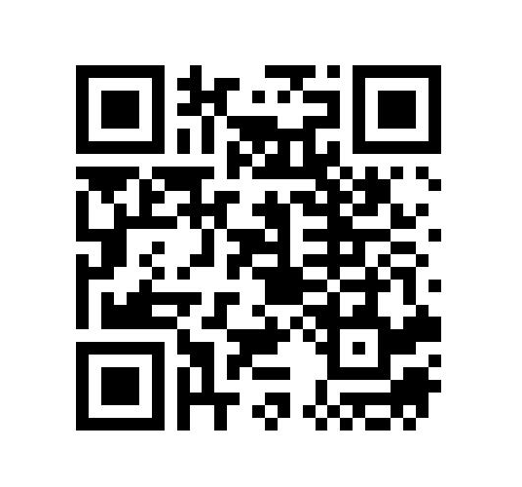
Now that we are done – some questions for you
Please open your phones and go to https://forms.gle/wNt4zZvLwNhzfR7o8
Notes:
7 question survey – Please help me understand how the presentation went.

